Slide 1
phonegap

Slide 2
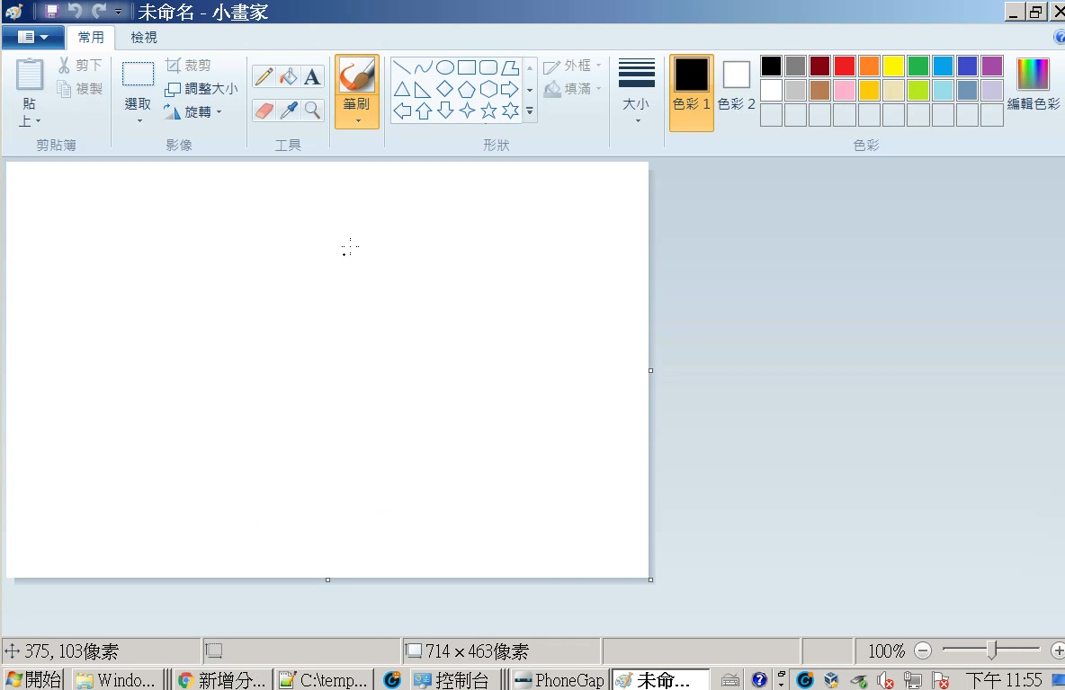

Slide 3
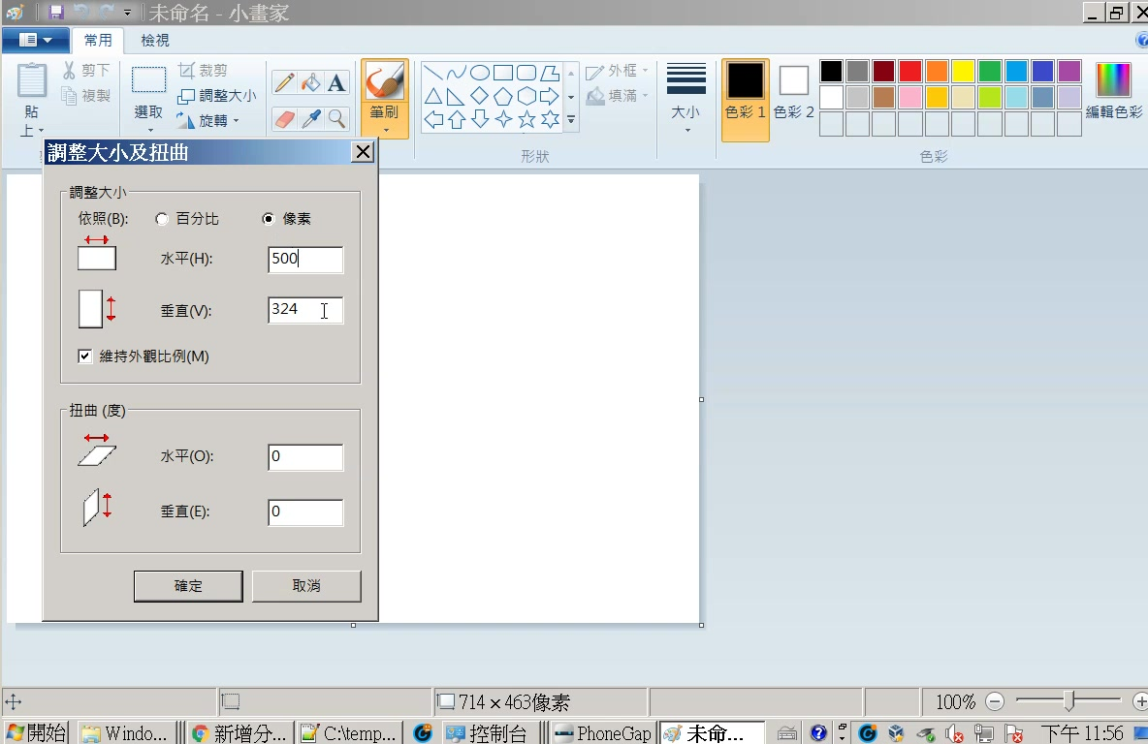

Slide 4
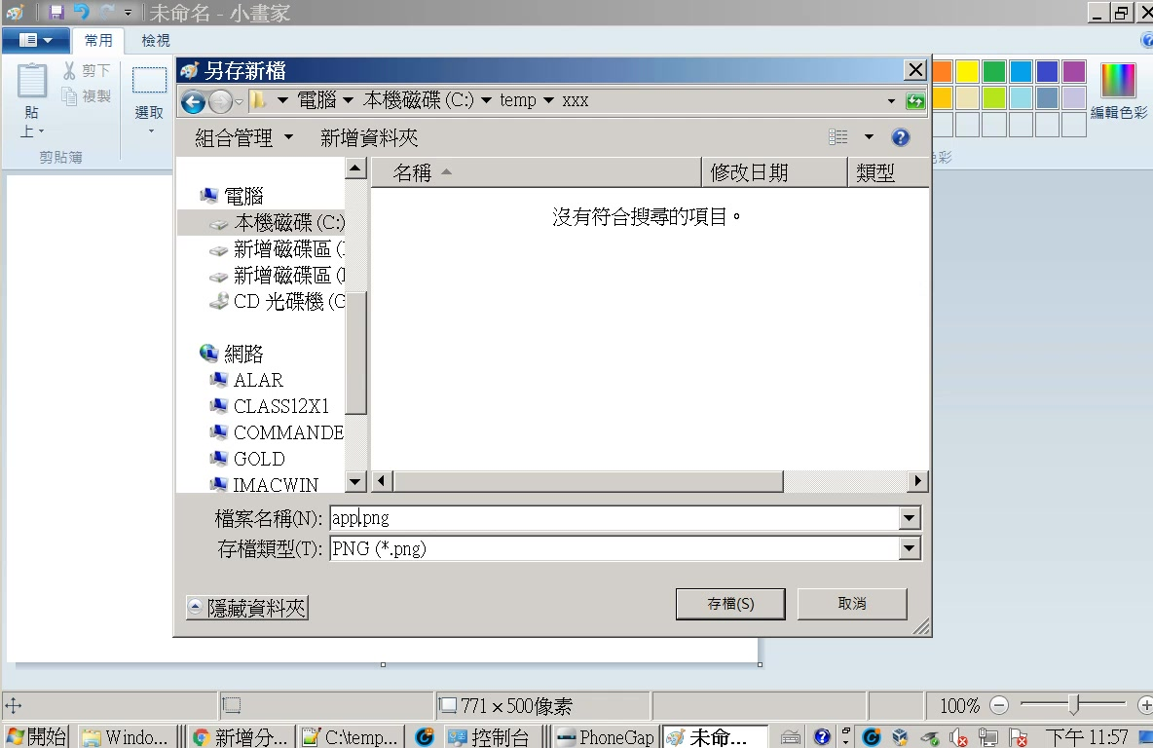

Slide 5
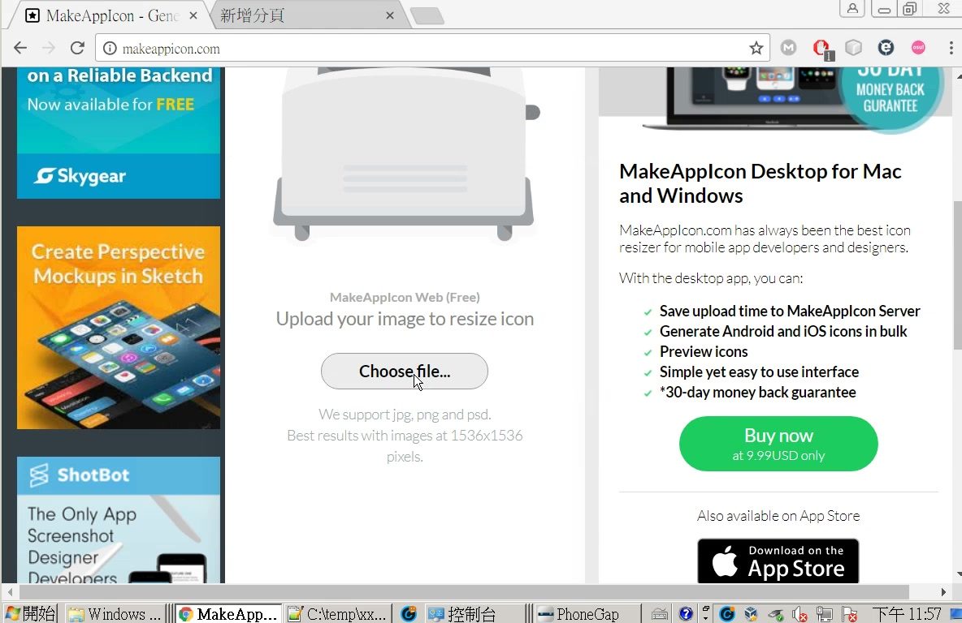
1
2

Slide 6
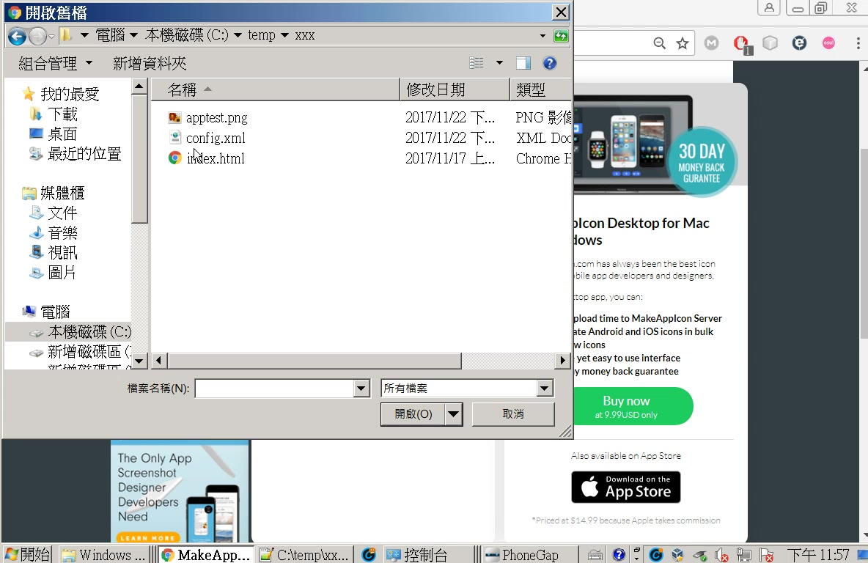

Slide 7
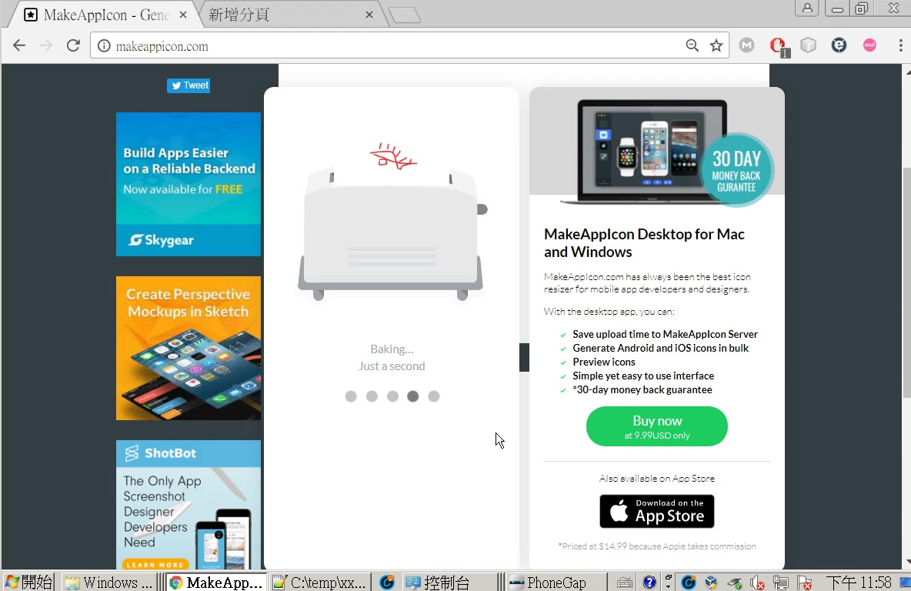

Slide 8
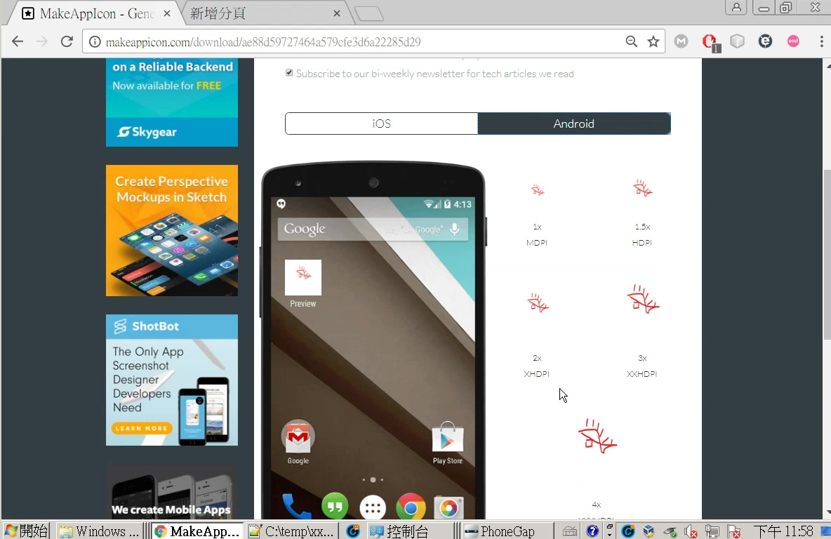

Slide 9
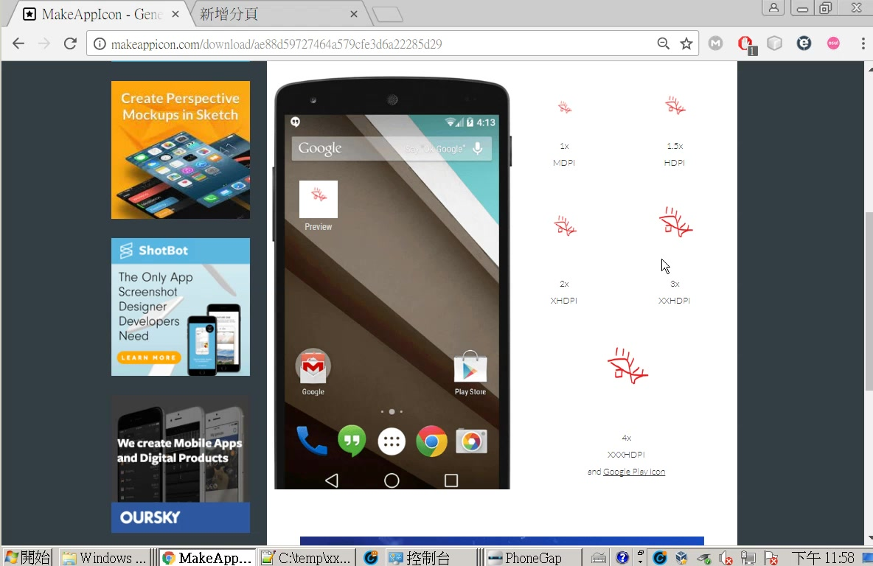
makeappicon.com
or
http://phonegap.appiq.software/

Slide 10
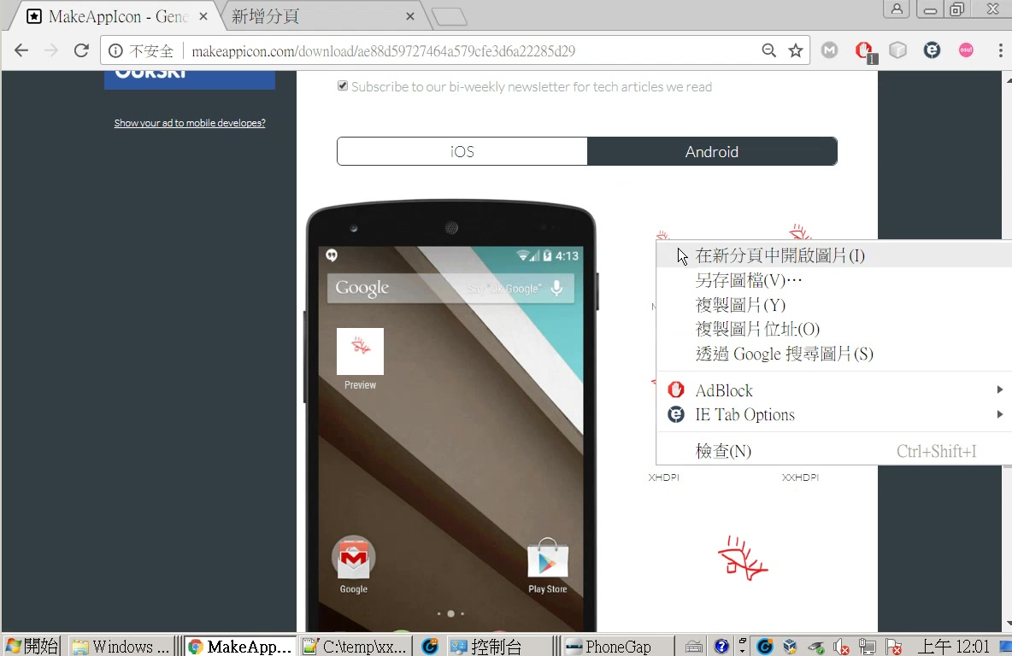

Slide 11
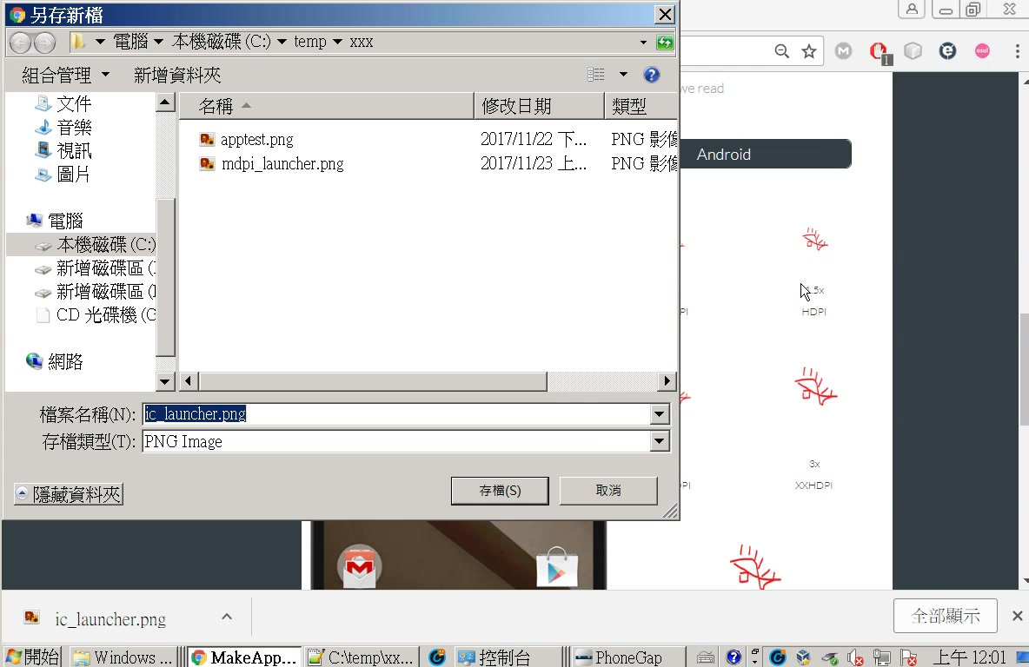
這是之前的mdpi
改成hdpi_launcher

Slide 12
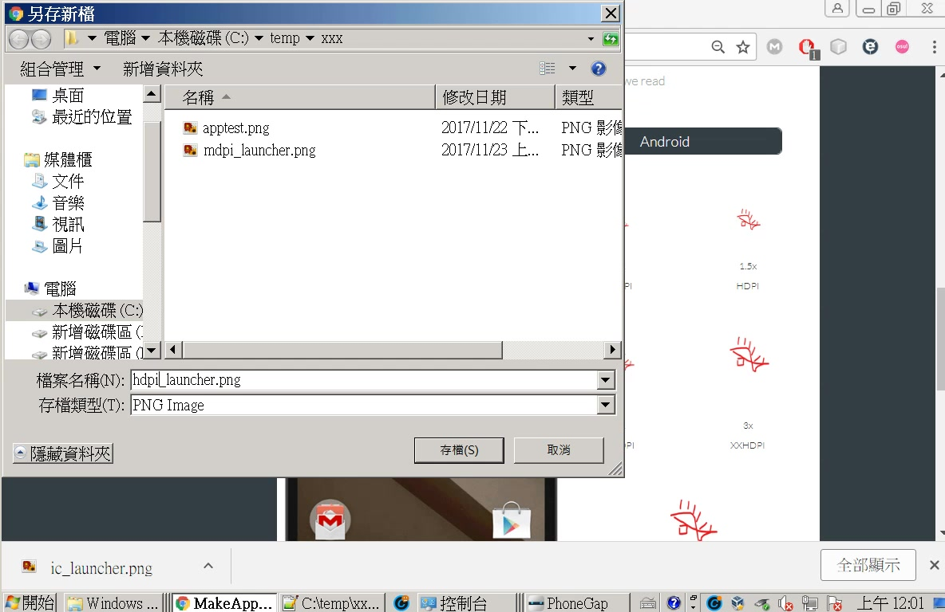

Slide 13
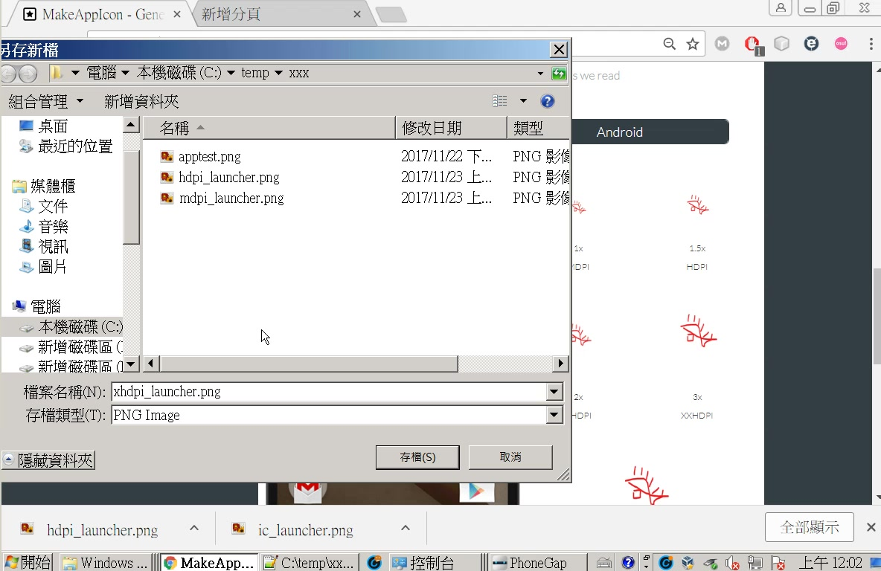

Slide 14
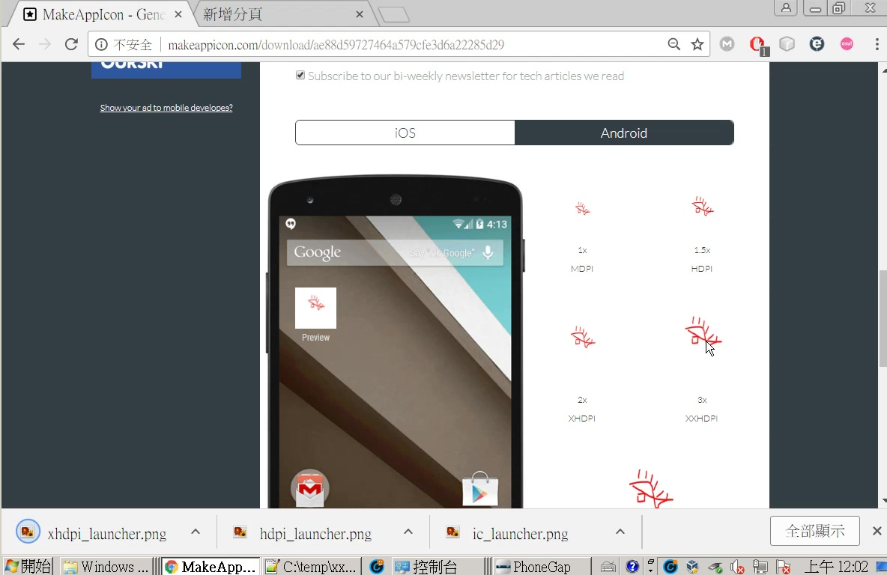
對照上個投影片

Slide 15
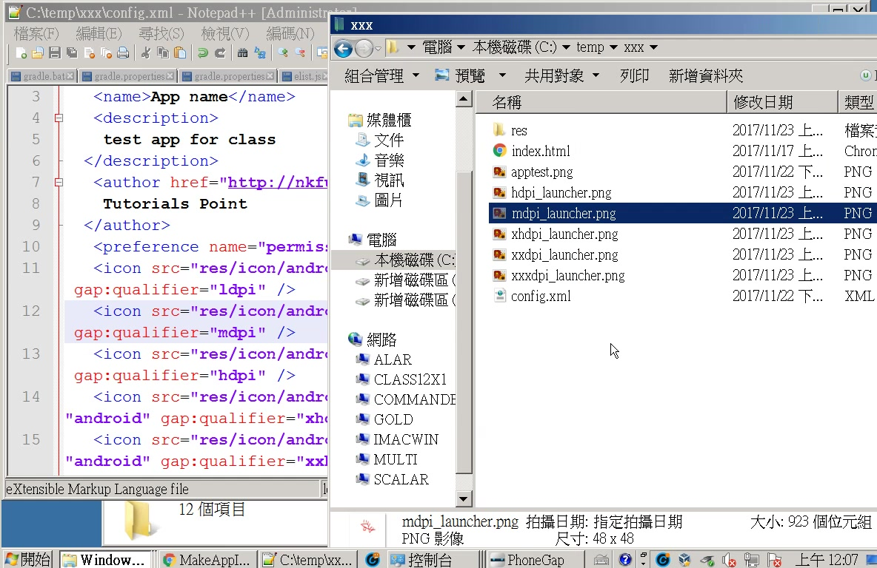

Slide 16
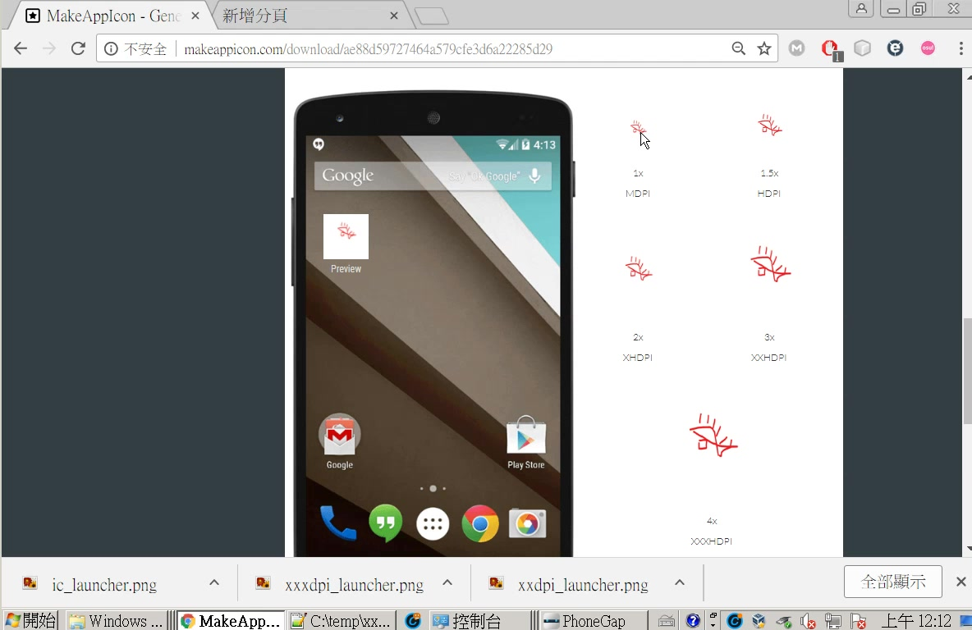

Slide 17
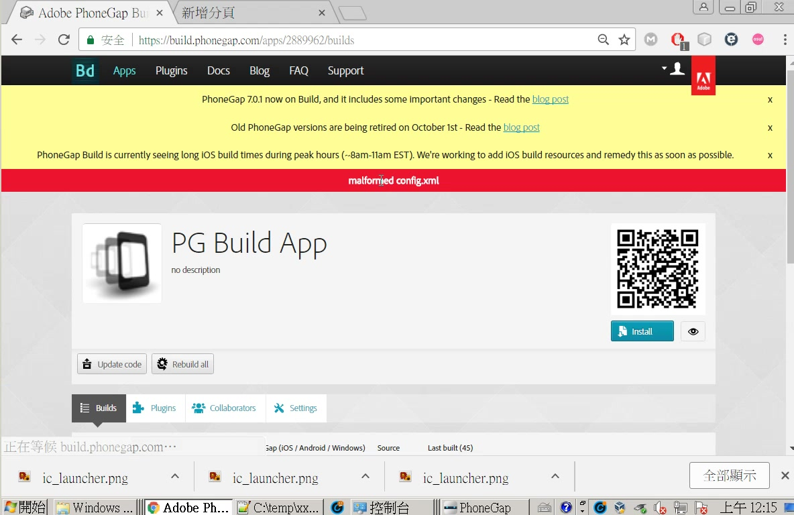
紅色表示發生錯誤

Slide 18
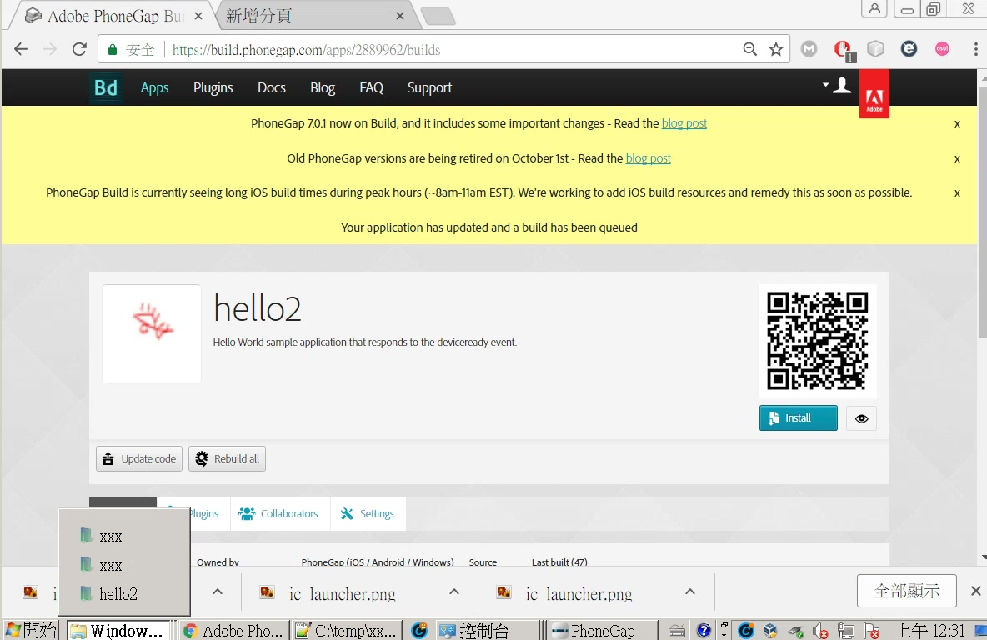

Slide 19
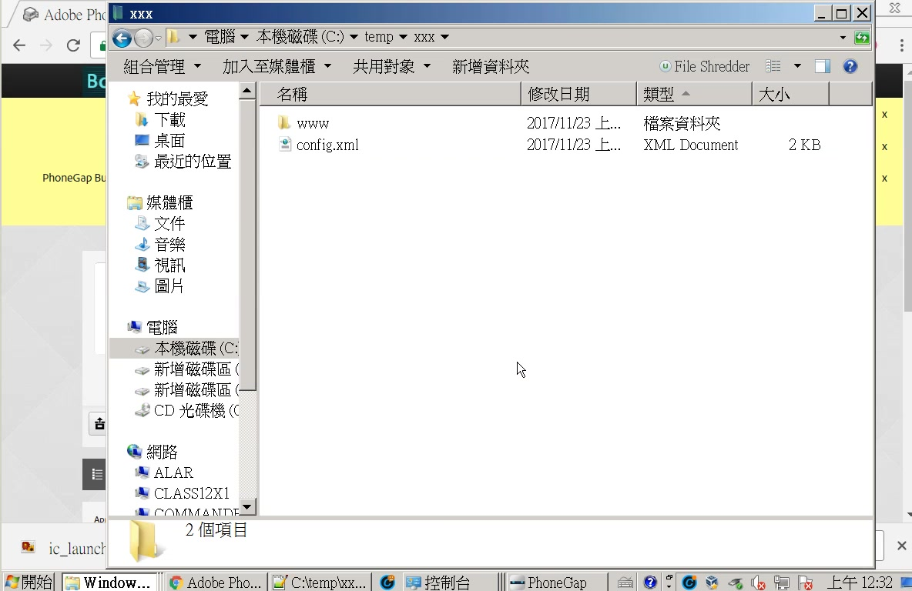

Slide 20
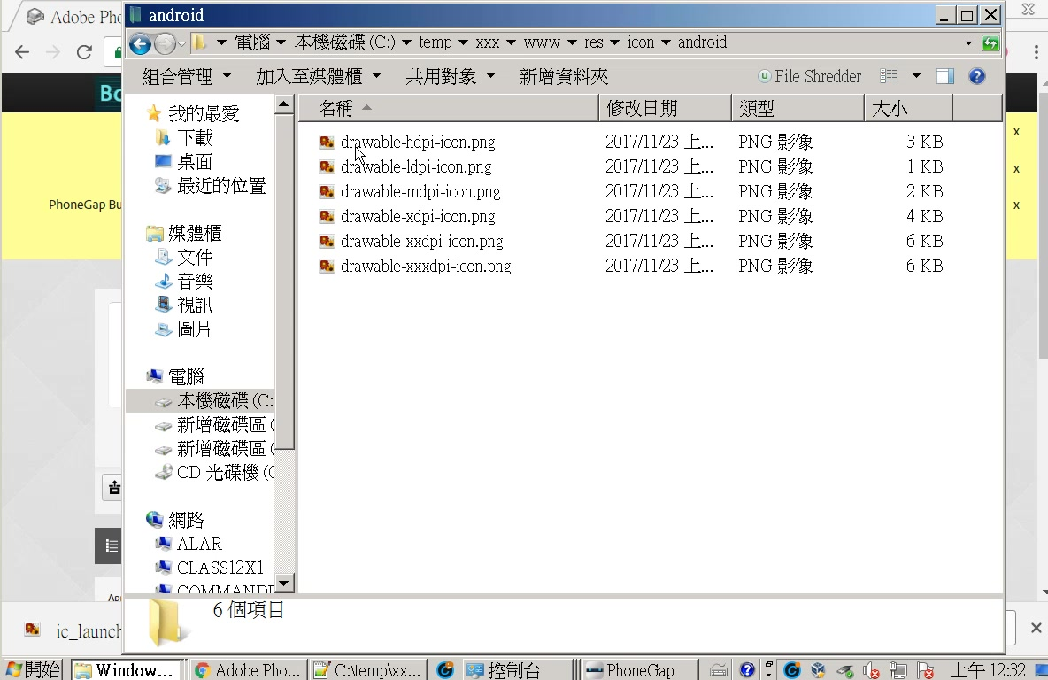

Slide 21
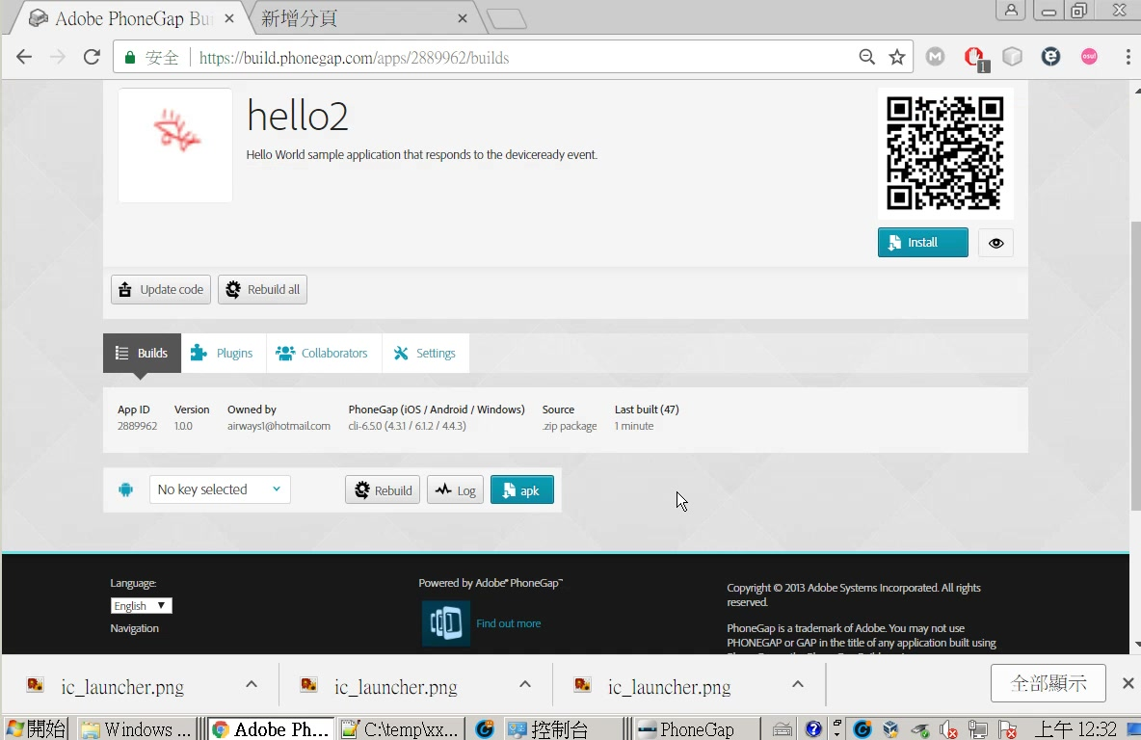

Slide 22
root.
│ config.xml
└─www
│ icon.png
│ index.html
│ splash.png
│
└─res
└─icons
├─android
│ drawable-hdpi-icon.png
│ drawable-ldpi-icon.png
│ drawable-mdpi-icon.png
│ drawable-xhdpi-icon.png
│ drawable-xxhdpi-icon.png
│ drawable-xxxhdpi-icon.png
│
└─ios
icon-40.png
icon-40@2x.png
...
省略
...
icon@2x.png
config.xml
res
icons
www
icon.png
index.html
splash.png
android
drawable-hdpi-icon.png
drawable-ldpi-icon.png
drawable-mdpi-icon.png
drawable-xhdpi-icon.png
drawable-xxhdpi-icon.png
drawable-xxxhdpi-icon.png
icon-40.png
icon-40@2x.png
...
省略
...
icon@2x.png
ios

Slide 23
config.xml

Slide 24
<?xml version='1.0' encoding='utf-8'?>
<widget id="edu.xx.xx" version="1.0.0" xmlns="http://www.w3.org/ns/widgets" xmlns:gap="http://phonegap.com/ns/1.0">
<name>hello2</name>
<description>
Hello World sample application that responds to the deviceready event.
</description>
<author email="support@phonegap.com" href="http://phonegap.com">
PhoneGap Team
</author>
<content src="index.html" />
<preference name="permissions" value="none" />
<platform name="android">
<icon density="ldpi" src="res/icons/android/drawable-ldpi-icon.png" />
<icon density="mdpi" src="res/icons/android/drawable-mdpi-icon.png" />
<icon density="hdpi" src="res/icons/android/drawable-hdpi-icon.png" />
<icon density="xhdpi" src="res/icons/android/drawable-xhdpi-icon.png" />
<icon density="xxhdpi" src="res/icons/android/drawable-xxhdpi-icon.png" />
<icon density="xxxhdpi" src="res/icons/android/drawable-xxxhdpi-icon.png" />
</platform>
<platform name="ios">
<icon height="57" platform="ios" src="res/icons/ios/icon.png" width="57" />
<icon height="114" platform="ios" src="res/icons/ios/icon@2x.png" width="114" />
<icon height="40" platform="ios" src="res/icons/ios/icon-40.png" width="40" />
<icon height="80" platform="ios" src="res/icons/ios/icon-40@2x.png" width="80" />
<icon height="50" platform="ios" src="res/icons/ios/icon-50.png" width="50" />
<icon height="100" platform="ios" src="res/icons/ios/icon-50@2x.png" width="100" />
<icon height="60" platform="ios" src="res/icons/ios/icon-60.png" width="60" />
<icon height="120" platform="ios" src="res/icons/ios/icon-60@2x.png" width="120" />
<icon height="180" platform="ios" src="res/icons/ios/icon-60@3x.png" width="180" />
<icon height="72" platform="ios" src="res/icons/ios/icon-72.png" width="72" />
<icon height="144" platform="ios" src="res/icons/ios/icon-72@2x.png" width="144" />
<icon height="76" platform="ios" src="res/icons/ios/icon-76.png" width="76" />
<icon height="152" platform="ios" src="res/icons/ios/icon-76@2x.png" width="152" />
<icon height="29" platform="ios" src="res/icons/ios/icon-small.png" width="29" />
<icon height="58" platform="ios" src="res/icons/ios/icon-small@2x.png" width="58" />
<icon height="87" platform="ios" src="res/icons/ios/icon-small@3x.png" width="87" />
</platform>
</widget>

Slide 25
<?xml version='1.0' encoding='utf-8'?>
<widget id="edu.xx.xx" version="1.0.0" xmlns="http://www.w3.org/ns/widgets" xmlns:gap="http://phonegap.com/ns/1.0">
<name>hello2</name>
<description>
Hello World sample application that responds to the deviceready event.
</description>
<author email="support@phonegap.com" href="http://phonegap.com">
PhoneGap Team
</author>
<content src="index.html" />
<preference name="permissions" value="none" />
<platform name="android">
<icon density="ldpi" src="res/icons/android/drawable-ldpi-icon.png" />
<icon density="mdpi" src="res/icons/android/drawable-mdpi-icon.png" />
<icon density="hdpi" src="res/icons/android/drawable-hdpi-icon.png" />
<icon density="xhdpi" src="res/icons/android/drawable-xhdpi-icon.png" />
<icon density="xxhdpi" src="res/icons/android/drawable-xxhdpi-icon.png" />
<icon density="xxxhdpi" src="res/icons/android/drawable-xxxhdpi-icon.png" />
</platform>
<platform name="ios">
<icon height="57" platform="ios" src="res/icons/ios/icon.png" width="57" />
<icon height="114" platform="ios" src="res/icons/ios/icon@2x.png" width="114" />
<icon height="40" platform="ios" src="res/icons/ios/icon-40.png" width="40" />
<icon height="80" platform="ios" src="res/icons/ios/icon-40@2x.png" width="80" />
<icon height="50" platform="ios" src="res/icons/ios/icon-50.png" width="50" />
<icon height="100" platform="ios" src="res/icons/ios/icon-50@2x.png" width="100" />
<icon height="60" platform="ios" src="res/icons/ios/icon-60.png" width="60" />
<icon height="120" platform="ios" src="res/icons/ios/icon-60@2x.png" width="120" />
<icon height="180" platform="ios" src="res/icons/ios/icon-60@3x.png" width="180" />
<icon height="72" platform="ios" src="res/icons/ios/icon-72.png" width="72" />
<icon height="144" platform="ios" src="res/icons/ios/icon-72@2x.png" width="144" />
<icon height="76" platform="ios" src="res/icons/ios/icon-76.png" width="76" />
<icon height="152" platform="ios" src="res/icons/ios/icon-76@2x.png" width="152" />
<icon height="29" platform="ios" src="res/icons/ios/icon-small.png" width="29" />
<icon height="58" platform="ios" src="res/icons/ios/icon-small@2x.png" width="58" />
<icon height="87" platform="ios" src="res/icons/ios/icon-small@3x.png" width="87" />
</platform>
</widget>
config.xml
res
icons
www
icon.png
index.html
splash.png
android
drawable-hdpi-icon.png
drawable-ldpi-icon.png
drawable-mdpi-icon.png
drawable-xhdpi-icon.png
drawable-xxhdpi-icon.png
drawable-xxxhdpi-icon.png
icon-40.png
icon-40@2x.png
...
省略
...
icon@2x.png
ios

Slide 26
<platform name="android">
<icon density="ldpi" src="res/icons/android/drawable-ldpi-icon.png" />
<icon density="mdpi" src="res/icons/android/drawable-mdpi-icon.png" />
<icon density="hdpi" src="res/icons/android/drawable-hdpi-icon.png" />
<icon density="xhdpi" src="res/icons/android/drawable-xhdpi-icon.png" />
<icon density="xxhdpi" src="res/icons/android/drawable-xxhdpi-icon.png" />
<icon density="xxxhdpi" src="res/icons/android/drawable-xxxhdpi-icon.png" />
</platform>
<platform name="ios">
<icon height="57" platform="ios" src="res/icons/ios/icon.png" width="57" />
<icon height="114" platform="ios" src="res/icons/ios/icon@2x.png" width="114" />
<icon height="40" platform="ios" src="res/icons/ios/icon-40.png" width="40" />
<icon height="80" platform="ios" src="res/icons/ios/icon-40@2x.png" width="80" />
<icon height="50" platform="ios" src="res/icons/ios/icon-50.png" width="50" />
<icon height="100" platform="ios" src="res/icons/ios/icon-50@2x.png" width="100" />
<icon height="60" platform="ios" src="res/icons/ios/icon-60.png" width="60" />
<icon height="120" platform="ios" src="res/icons/ios/icon-60@2x.png" width="120" />
<icon height="180" platform="ios" src="res/icons/ios/icon-60@3x.png" width="180" />
<icon height="72" platform="ios" src="res/icons/ios/icon-72.png" width="72" />
<icon height="144" platform="ios" src="res/icons/ios/icon-72@2x.png" width="144" />
<icon height="76" platform="ios" src="res/icons/ios/icon-76.png" width="76" />
<icon height="152" platform="ios" src="res/icons/ios/icon-76@2x.png" width="152" />
<icon height="29" platform="ios" src="res/icons/ios/icon-small.png" width="29" />
<icon height="58" platform="ios" src="res/icons/ios/icon-small@2x.png" width="58" />
<icon height="87" platform="ios" src="res/icons/ios/icon-small@3x.png" width="87" />
</platform>

Slide 27
drawable-xxxhdpi-icon: 192 x 192
drawable-xxhdpi-icon.png: 144 x 144
drawable-xhdpi-icon: 96 x96
drawable-hdpi-icon.png: 72 x 72
drawable-mdpi-icon.png: 48x 48
drawable-ldpi-icon.png: 36x36

